Slide 1
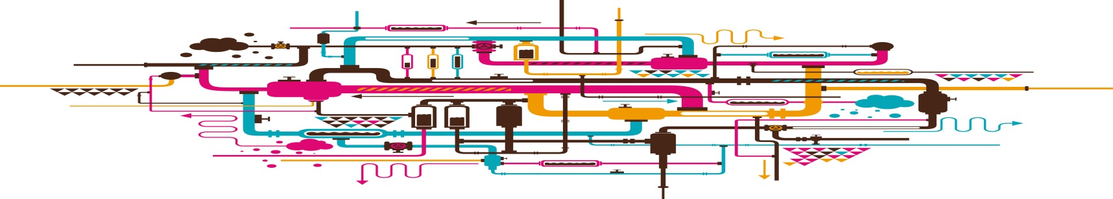
Next Generation
Librarian Training
Belinda Weaver
@cloudaus
#nglt

Slide 2




Jobs I have had in the past 15 years
Liaison Librarian
Internet Trainer
Web Columnist
Repository Manager
Newspaper Columnist
Journalism Lecturer
Book Author
Project Manager
Branch Library Manager
Manager, Research Data Collections Service
Project Manager, AustLit
Training Co-ordinator, QCIF
eResearch Analyst Team Leader, QCIF
Certified instructor

Slide 3
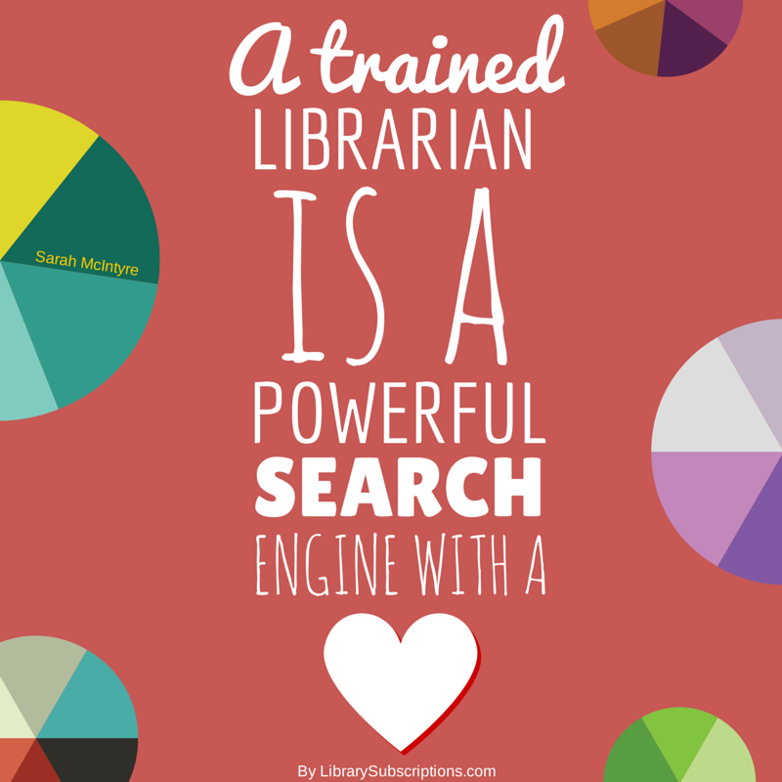


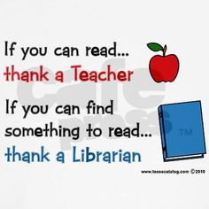
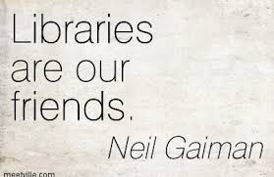

Slide 4

SWOT analysis - Strengths
Users need, want, love libraries, and they value the expertise and support of the staff.
‘Library’ as a term has universal awareness and the strength of the brand has developed over centuries.
Libraries are not simply about the materials and the technology, they help satisfy the need for people to connect.
Libraries ensure access to books, resources and technology for everyone, promoting equality of opportunity.
https://www.alia.org.au/futureoftheprofession

Slide 5
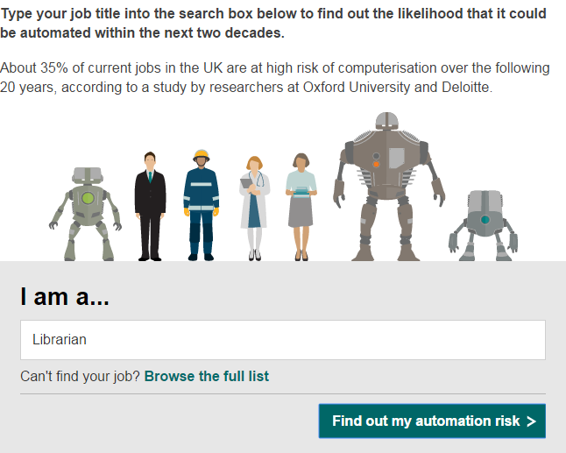
Will a robot take your job?
http://www.bbc.com/news/technology-34066941

Slide 6
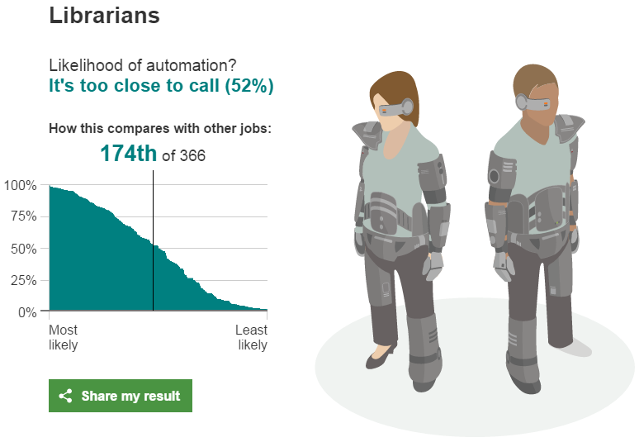
52% is pretty high – and it’s more likely than unlikely
http://www.bbc.com/news/technology-34066941

Slide 7
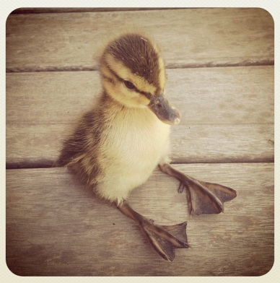
Losing the edge …?
1. The physical trap … investments in old systems prevent the pursuit of newer, more relevant ones
2. The psychological trap …failing to notice something new that could displace them
3. The strategic trap … focusing on the marketplace of today … and failing to anticipate the future
10 great companies that lost their edge US news [Online] 19 August 2012 [Cited 27 August 2013] money.usnews.com/money/blogs/flowchart/2010/08/19/10-great-companies-that-lost-their-edge

Slide 8


Bookshops
Bricks & mortar retail
Taxi industry
Hotels
Travel guidebooks
Travel agents
Landlines
Newspapers
DVD rentals
CD sales
Newspaper classifieds
Notes:
Bookshops – disappearing, threatened by Amazon, et al
Bricks & mortar retail – threatened by online businesses
Taxi industry – threatened by Uber
Hotels – threatened by Airbnb
Travel agents – threatened by online bookings
Landline phones – threatened by Skype, WhatsApp
Newspapers – dying, threatened by social media and other online news
DVD rentals – replaced by Netflix and other streaming services
CD sales – threatened by streaming services, iTunes, Spotify, Google Play Music
Film – replaced by digital cameras
Newspaper classifieds – replaced by seek | carsales | realestate |.com.au

Slide 9
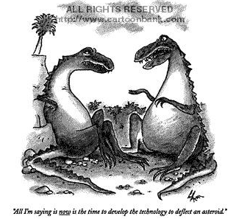
All I am saying is now is the time to develop the
technology to deflect an asteroid ...

Slide 10
Information Literacy
Social Networking
Online Reference Services
Fundamentals of Web Publishing
Marketing
Community Histories
Preservation of Information Resources
Project Management
Services for Children and Youth
Community Outreach
Human Resource Management
Principles of Knowledge Management
Community Informatics
Preservation of Audiovisual Materials
Digital Preservation
Value-Added Information Services
Research Data Management
Application of Bibliographic Standards
Information Services Around the World
Information Retrieval Systems and Practice

Slide 11
Research Data Management
This subject will provide information managers with the background to provide leadership in data management.
Learning outcome
- be able to reflect critically and demonstrate understanding of the issues and trends in data management and curation.

Slide 12
“We’re doing them a disservice if we’re only teaching them to operate or contemplate these platforms from the outside …”
https://lareviewofbooks.org/article/digital-humanities-interview-bethany-nowviskie/

Slide 13
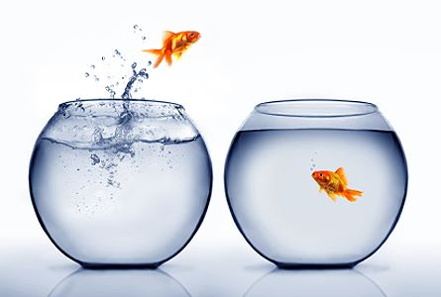
In many cases, traditions last not because they are excellent, but because influential people are averse to change and because of the sheer burdens of transition to a better state.
— Cass Sunstein Infotopia: How Many Minds Produce Knowledge

Slide 14
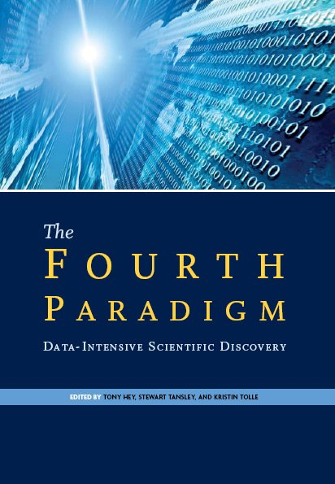
A new era in research
A thousand years ago:
science was empirical
describing natural phenomena
Last few hundred years:
A theoretical branch developed
using models, generalizations
Last few decades:
a computational branch developed
simulating complex phenomena
Now: data exploration (eResearch)
unify theory, experiment, and simulation
    – Data captured by instruments or generated by simulators
    – Data outputs too large to be processed by humans
    – Scientists use statistical software and analytical tools such as data mining, visualisation and simulation
http://research.microsoft.com/en-us/collaboration/fourthparadigm/

Slide 15
In one day, a high-throughput DNA-sequencing machine can read about 26 billion characters of the human genetic code. That translates into 9 terabytes – or 9 trillion data units – in one year; alongside it is a wealth of related information that can be 20 times more voluminous.
The total data flow: more than 20 new US Libraries of Congress each and every year.
That is from one specialised instrument, in one scientific sub-discipline; enlarge that picture across all of science, across the world, and you start to see the … challenge presented.
RIDING THE WAVE: How Europe can gain from the rising tide of scientific data

Slide 16
What is eResearch?
Applying advanced information / communications technologies to the practice of research
eResearch enables researchers to:
  draw on global resources
  develop new insights and solutions to complex problems
  collaborate with researchers anywhere
  expand the scale and scope of research issues that can be addressed

Slide 17
Technologies
Technologies in eResearch include:
  large-scale data sharing and storage
  high speed networks
  online collaborative tools
  high performance computing for simulations, modelling and visualisation.

Slide 18
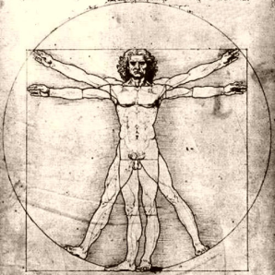
State of play in the humanities
little take-up of tools for text-mining, cloud computing, or the semantic web
limited uptake of freely available tools for data management and data sharing
adoption and take up of new technologies and services hampered by lack of awareness and lack of support
http://www.rin.ac.uk/our-work/using-and-accessing-information-resources/information-use-case-studies-humanities

Slide 19

… in the life sciences
strong desire for information support, closely integrated with research teams and laboratories
reluctance to adopt new tools and services – hampered by lack of awareness and lack of training and support
emerging specialist roles required – bioinformaticians, statisticians, modellers and curators
http://www.rin.ac.uk/our-work/using-and-accessing-information-resources/patterns-information-use-and-exchange-case-studie

Slide 20

… in the physical sciences
high reliance on field-specific bespoke tools
low awareness of good search practices
data analysis central to scientific work and programming skills increasingly important
need help with metadata
http://www.rin.ac.uk/our-work/using-and-accessing-information-resources/physical-sciences-case-studies-use-and-discovery-

Slide 21
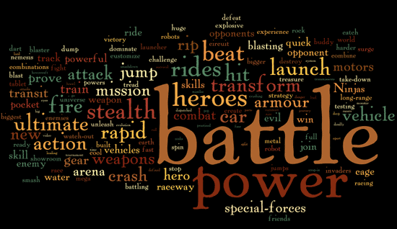
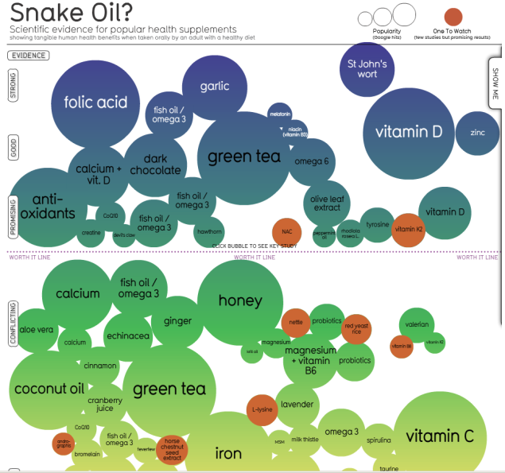
The game changers in research
Most Common Words In Toy Ads
Scope and scale – projects can go wider and bigger
Resources – vast numbers of datasets available, easier to find and share data of all kinds
New digital tools – data mining, visualisation, sharing, collaborating
Crowdsourcing – the growth of ‘citizen’ science
Expectations – that data will be made open
Images from
http://www.informationisbeautiful.net/
The evidence for health supplements

Slide 22
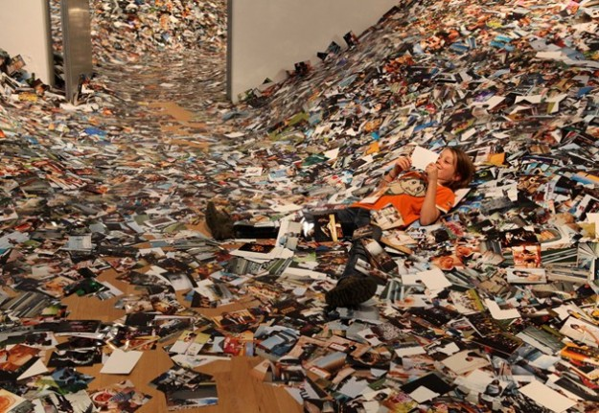
There’s lots of data …
Photos uploaded to Flickr in just one 24-hour period

Slide 23

Increasingly, you need the data to understand the research
Geoffrey Boulton* argues that since no journal can spare the space to publish the avalanche of data points that large-scale scientific experiments produce, the published paper has become more of an ‘advertisement’ and the ‘science sits in the underlying data’.
Quoted in An open and shut case? Debating the purposes of open science, a Royal Society PolicyLab meeting (mp3 file).
http://downloads.royalsociety.org/audio/Policy/policylab/2011-9-01SPSOpenScience.mp3
Geoffrey Boulton is a Fellow of the Royal Society and leads the Society's project, Science as a Public Enterprise.

Slide 24
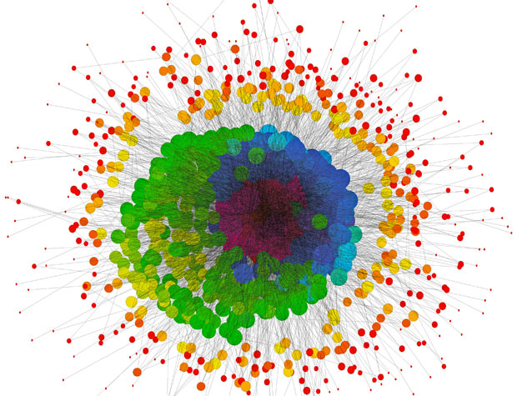
Ecologists use computers to simulate the effect of disasters on animal populations.
Biologists use computers to search massive amounts of DNA data.
Astronomers use computers to control vast arrays of telescopes, and then process the collected data.
Oceanographers use computers to combine data from satellites, ships and buoys to predict global climates.
Social scientists use computers to discover and predict the effects of policy or to analyze interview transcripts.
http://gizmodo.com/how-computers-broke-science-and-what-we-can-do-to-fix-i-1741649207

Slide 25

But …
Coding and data analysis are not routinely taught* as part of research training
* Except in disciplines such as mathematics or computer science
Notes:
Skills must be picked up
‘on the job’
through a researcher’s own initiative

Slide 26

A worldwide volunteer organisation whose goal is to make scientists more productive, and their work more reliable, by teaching them basic computing skills.

Slide 27
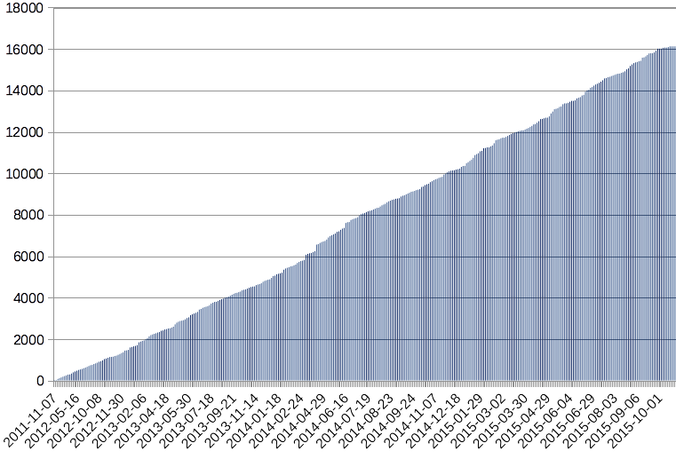
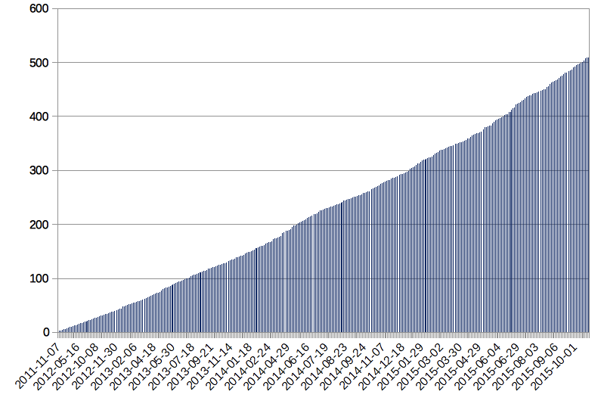
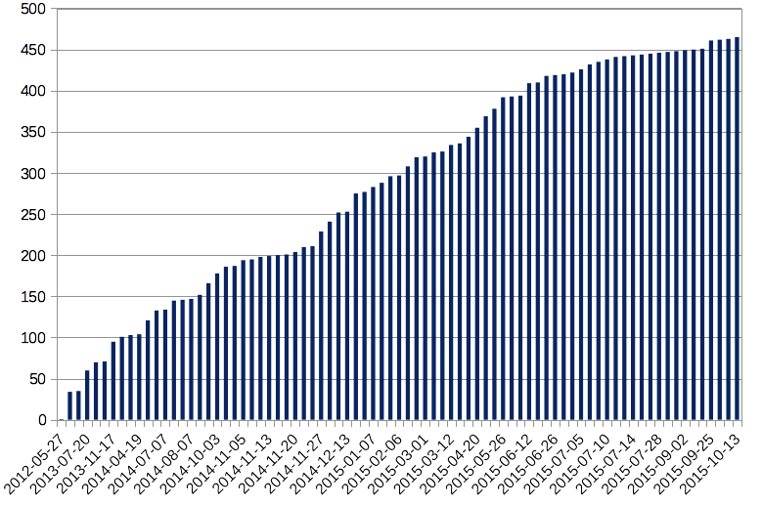
About …
Founded in 1998, rebooted in 2011/12
Learners
Workshops
Instructors
Numerous funders – past and present
http://software-carpentry.org/scf/supporters.html
Notes:
10,000 trained
Hundreds of workshops and instructors
Worldwide movement
Instructors in NSW, Victoria, Queensland and WA – soon ACT, South Australia
NZ also in

Slide 28


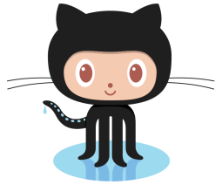


The Software Carpentry model
Short, intensive bootcamps that cover
  task automation using the Unix shell
  programming in Python, R, or MATLAB
  version control using GitHub or Mercurial
  data management using SQL

Slide 29


Short, intensive bootcamps that cover
  task automation using the Unix shell
  programming in Python and R
  version control using GitHub or Mercurial
  data management using SQL
  data cleanup using OpenRefine

Slide 30
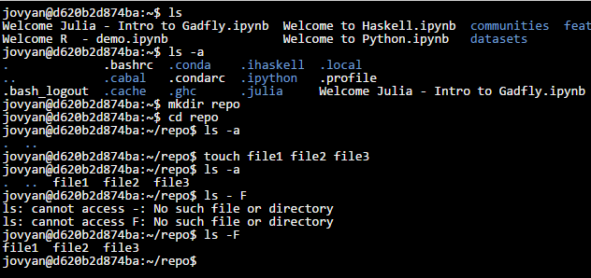
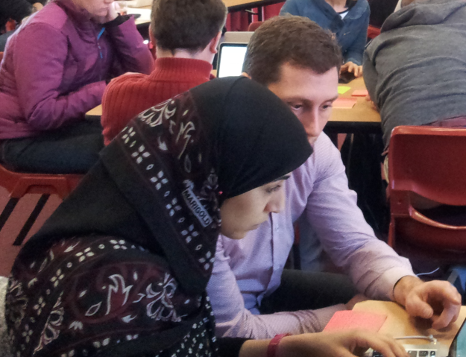

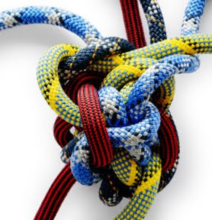

What makes Software Carpentry effective?
Notes:
Live coding
On your own machine
Structured exercises
Challenges
Peer to peer
Instructors make mistakes

Slide 31
Our job
A librarian is a person who works professionally in a library, providing access to information *
* https://en.wikipedia.org/wiki/Librarian

Slide 32
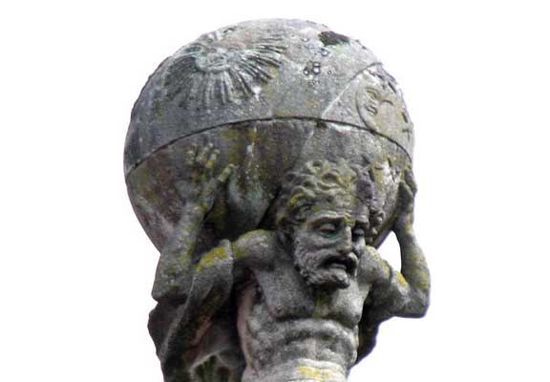
To support or not to support?
The most pressing need for many physical scientists is new technologies and tools for experimentation and data analysis, rather than more information resources …
http://www.rin.ac.uk/system/files/attachments/Phys_Sci_case_study_exec_summary.pdf

Slide 33
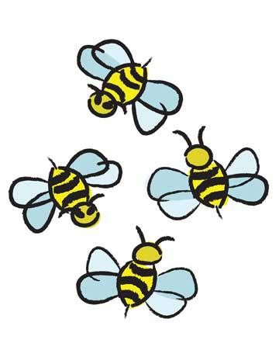
… librarians need to be flexible when it comes to engaging scientists and researchers, so that they can tap into field-specific needs rather than asking researchers to conform to librarian expectations.
These opportunities, where library professionals become scientific consultants …are one way for libraries to remain central to the research process.
http://www.rin.ac.uk/system/files/attachments/Phys_Sci_case_study_exec_summary.pdf

Slide 34
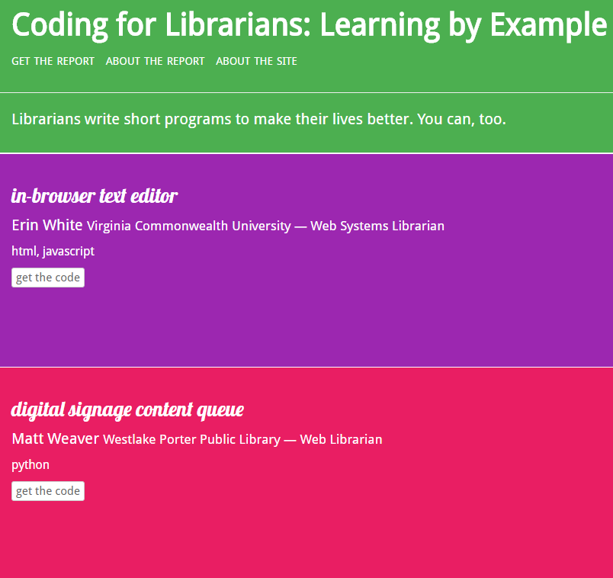
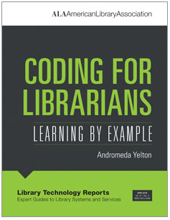

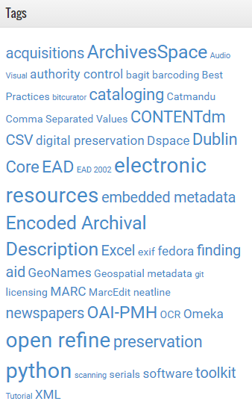
Andromeda
Yelton
https://thatandromeda.github.io/ltr/
Learning even the rudiments of coding can increase productivity and effectiveness
Scripts that present data to decision-makers
Streamline data import, export, clean-up
http://www.libraryworkflowexchange.org/

Slide 35
Fiona Tweedie: Why Code?
Because it gives you more control
Because it lets you customise and make alterations
Because it lets you understand what you’re getting
Because it refines your bullsh*t detector
http://melbourne.resbaz.edu.au/post/95320810834/why-code

Slide 36
Librarians have always played a crucial role in cultivating world class research. Yet, increasingly, all modern research involves some form of computation. If skills such as programming and data analysis are not routinely taught as part of a library science curriculum, what pathways exist for librarians to acquire these skills so they can go on to play a greater role in supporting researchers and in making greater use of the data generated within their own institutions?
Library Carpentry is one model for skills acquisition. How could it be put to use in rebooting librarianship for the 21st century – which is already tipped to be the century of big data?
-- Dr James Baker

Slide 37
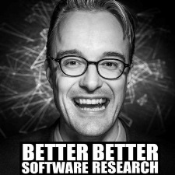
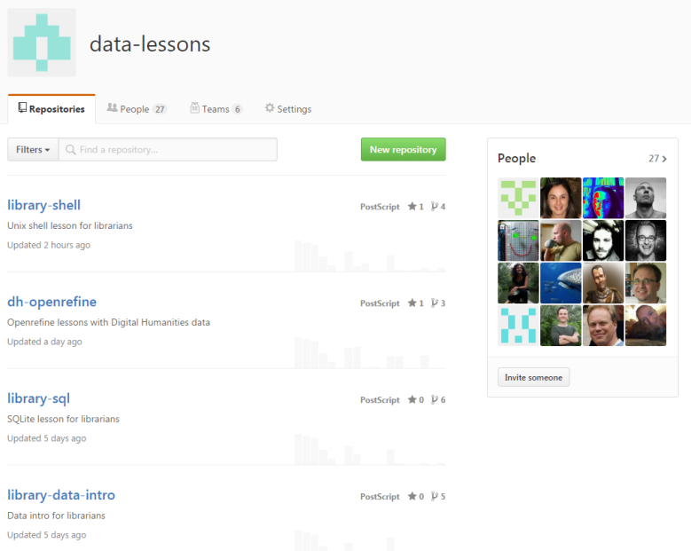
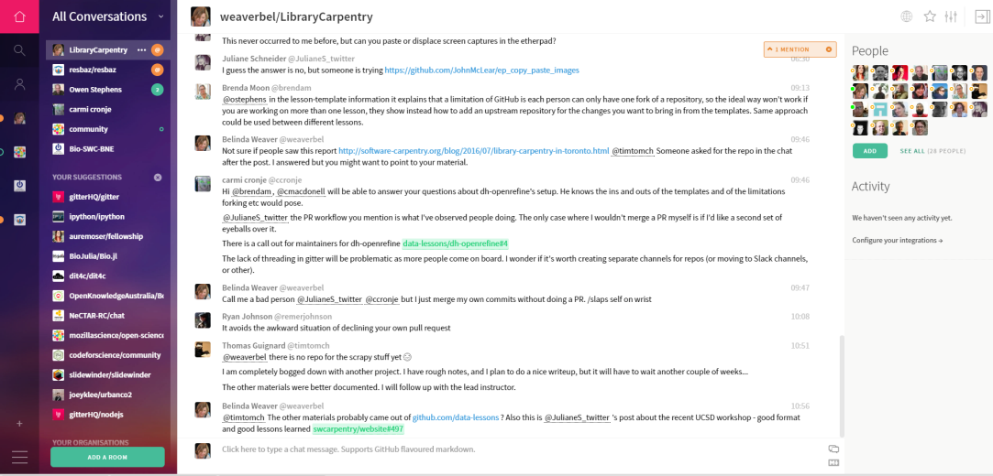
Library Carpentry
Initial course London 2015
The 2016 #mozsprint
Since the sprint (8 +)
https://github.com/data-lessons
Sprint teams: Brisbane, Sydney,
Perth, Capetown, Amsterdam,
London, San Diego, Pasadena,
Edmonton
https://gitter.im/weaverbel/LibraryCarpentry

Slide 38

What Library Carpentry teaches
Jargon busting
Data structures
Regular expressions
Using the command line
Version control
OpenRefine

Slide 39

What could you do?
  analyse statistics
  mine and count data
  automate repetitive tasks
  clean up your datasets
  search databases using regex
  find data within files
https://github.com/data-lessons

Slide 40
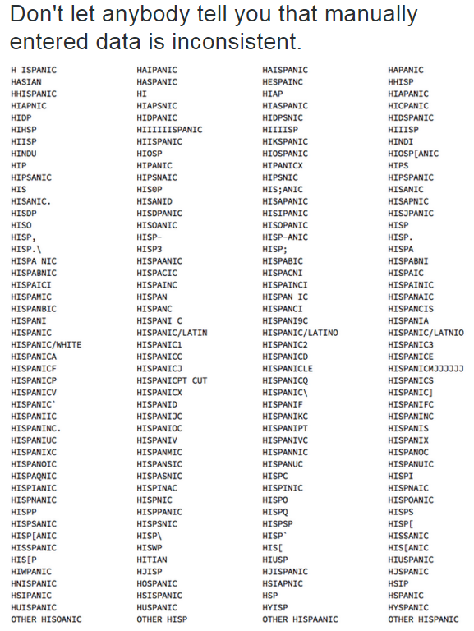

Yes, this kind of data …
https://twitter.com/veltman/status/459782149390860288

Slide 41

  For all ARC grant awardees for a given year
  … match with local researcher record
  …eliminate those with an ORCID in the repository
  … give me email addresses for remainder
  … generate & send a ‘join ORCID’ email
You could
automate all this with a Python script

Slide 42
And this …
For all policy documents
… with links from twitter
… give me the accounts
For those accounts …
… give me any linked DOIs
… give me the ORCIDs
For those ORCIDS …
With thanks to Cameron Neylon for the example

Slide 43
Does it work?
“The workshop was great. A few of us are already using regex/OpenRefine in our work and just looking for an excuse to rip some text apart with grep! I’m thinking about ways to keep up the momentum from the workshop, share our experiences and so on - so that we continue to get value from it and develop those skills.”
Feedback from JCU Townsville Library Carpentry session, 2016

Slide 44
Ideas on using the tools
Tidying up EndNote libraries – identify where data is missing
Wrangling data for bibliometric benchmarking exercises
Cleaning and standardising free text fields for reporting
Combining journal datasets for metrics analysis
Using OR to anonymise data in sensitive datasets
Turning unstructured data into categorised data
Using regex to find words or concepts within messy data
Combining data from multiple sets of course feedback
Removing duplicate records
Easily identifying where data is in the wrong fields

Slide 45
“… to communicate with other people you need to speak their language, and coding is the language of computation … you need to understand what computers are (and aren’t) good at in order to come up with intelligent computational problems and solutions.
[Also] each stage of computational abstraction involves decisions that are essentially acts of interpretation, and you can’t do meaningful work if you don’t understand that.”
https://lareviewofbooks.org/article/digital-humanities-interview-pamela-fletcher/

Slide 46
Would you trust a book on the French Revolution written by a scholar who didn’t read French? I’m sure there are brilliant lunar geologists who have never been to the moon. But I maintain that one must learn one’s materials — including computation and coding — in order to be competent in digital humanities …
It’s less important to master the specific syntax of a single computer language than it is to understand certain fundamental concepts that many languages share, concepts like variables, iteration, and subroutines.
https://lareviewofbooks.org/article/the-digital-in-the-humanities-an-interview-with-alexander-galloway/

Slide 47
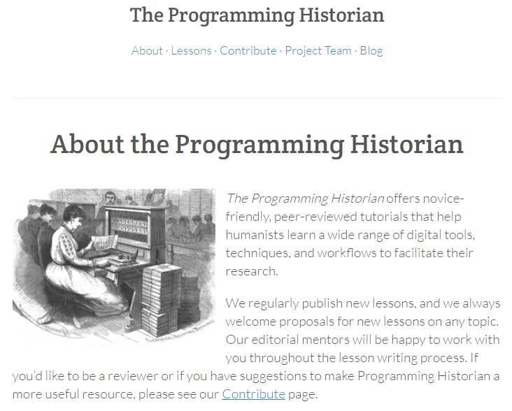
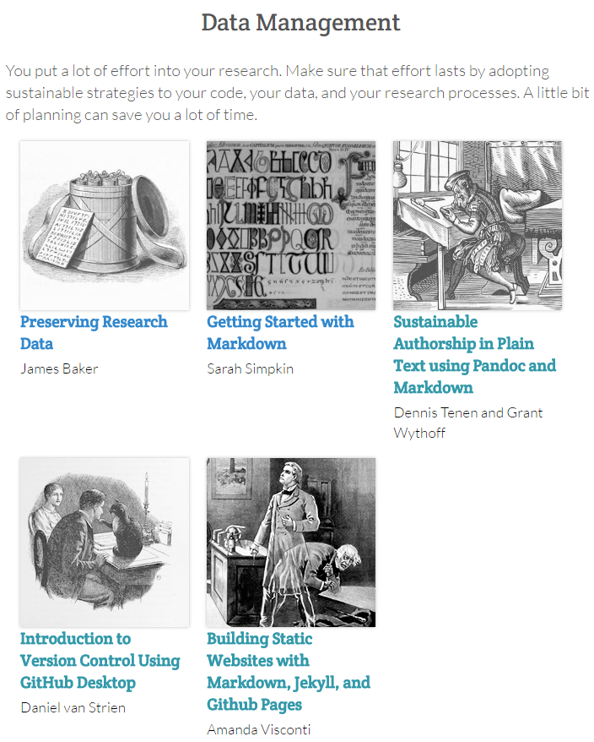
Example lessons
Online
Self-paced lessons
http://programminghistorian.org/lessons/

Slide 48
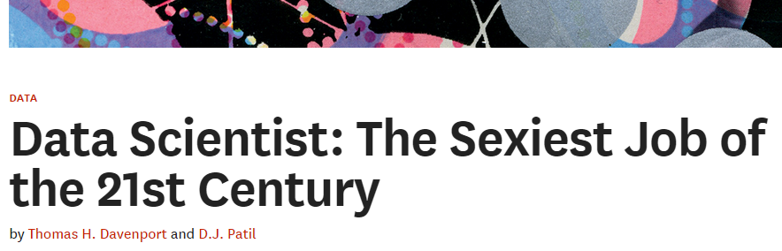
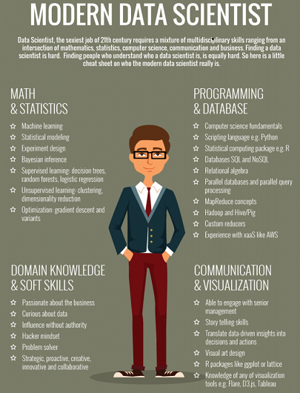

Harvard Business Review: https://hbr.org/2012/10/data-scientist-the-sexiest-job-of-the-21st-century/
“Data scientists’ most basic, universal skill is the ability to write code. ”

Slide 49




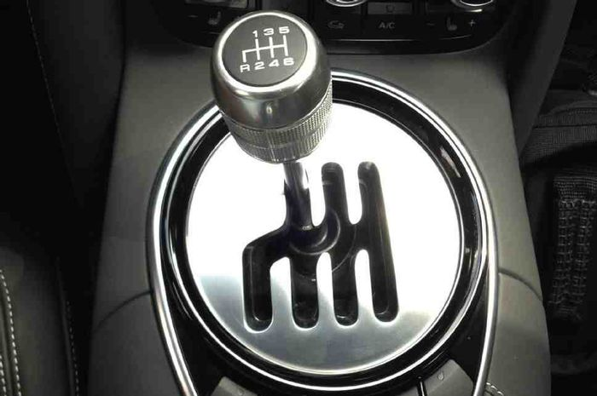
good enough
automation

Slide 50
Academic libraries
Teach tools such as OpenRefine/command line
Foster sustainable authorship practices
Specialise in 1-2 skills and teach them
Bring in experts to run clinics
Data-Scientist-In-Residence
Join Hacky Hours or start your own
Take part in the annual Research Bazaar (ResBaz)
Sponsor Software and Data Carpentry workshops

Slide 51
Public and state libraries
Develop and support local crowdsourced projects
Develop tools to record local history, e.g. capture residents’ stories and images, interview residents of old people’s homes
Run ‘crypto’ clinics to teach people how to protect themselves online and with IoT
Teach free alternatives to expensive software and OS, e.g. Linux, OpenOffice

Slide 52
How do you get skills?
Attend a workshop
Help at a workshop
Use online courses
Teach them!

Slide 53
“There is a tide in the affairs of men,
Which taken at the flood, leads on to fortune.
Omitted, all the voyage of their life is bound in
shallows and in miseries.
On such a full sea are we now afloat.
And we must take the current when it serves, or lose our ventures.”
-- William Shakespeare, Julius Caesar

Slide 54


