Slide 1

Enhancing online learning:
Promoting student engagement through partnership with local libraries
Presenters: Rose Hill Pamela McGowan
Student Engagement Coordinator Librarian
Open Universities Australia Monash Council

Slide 2
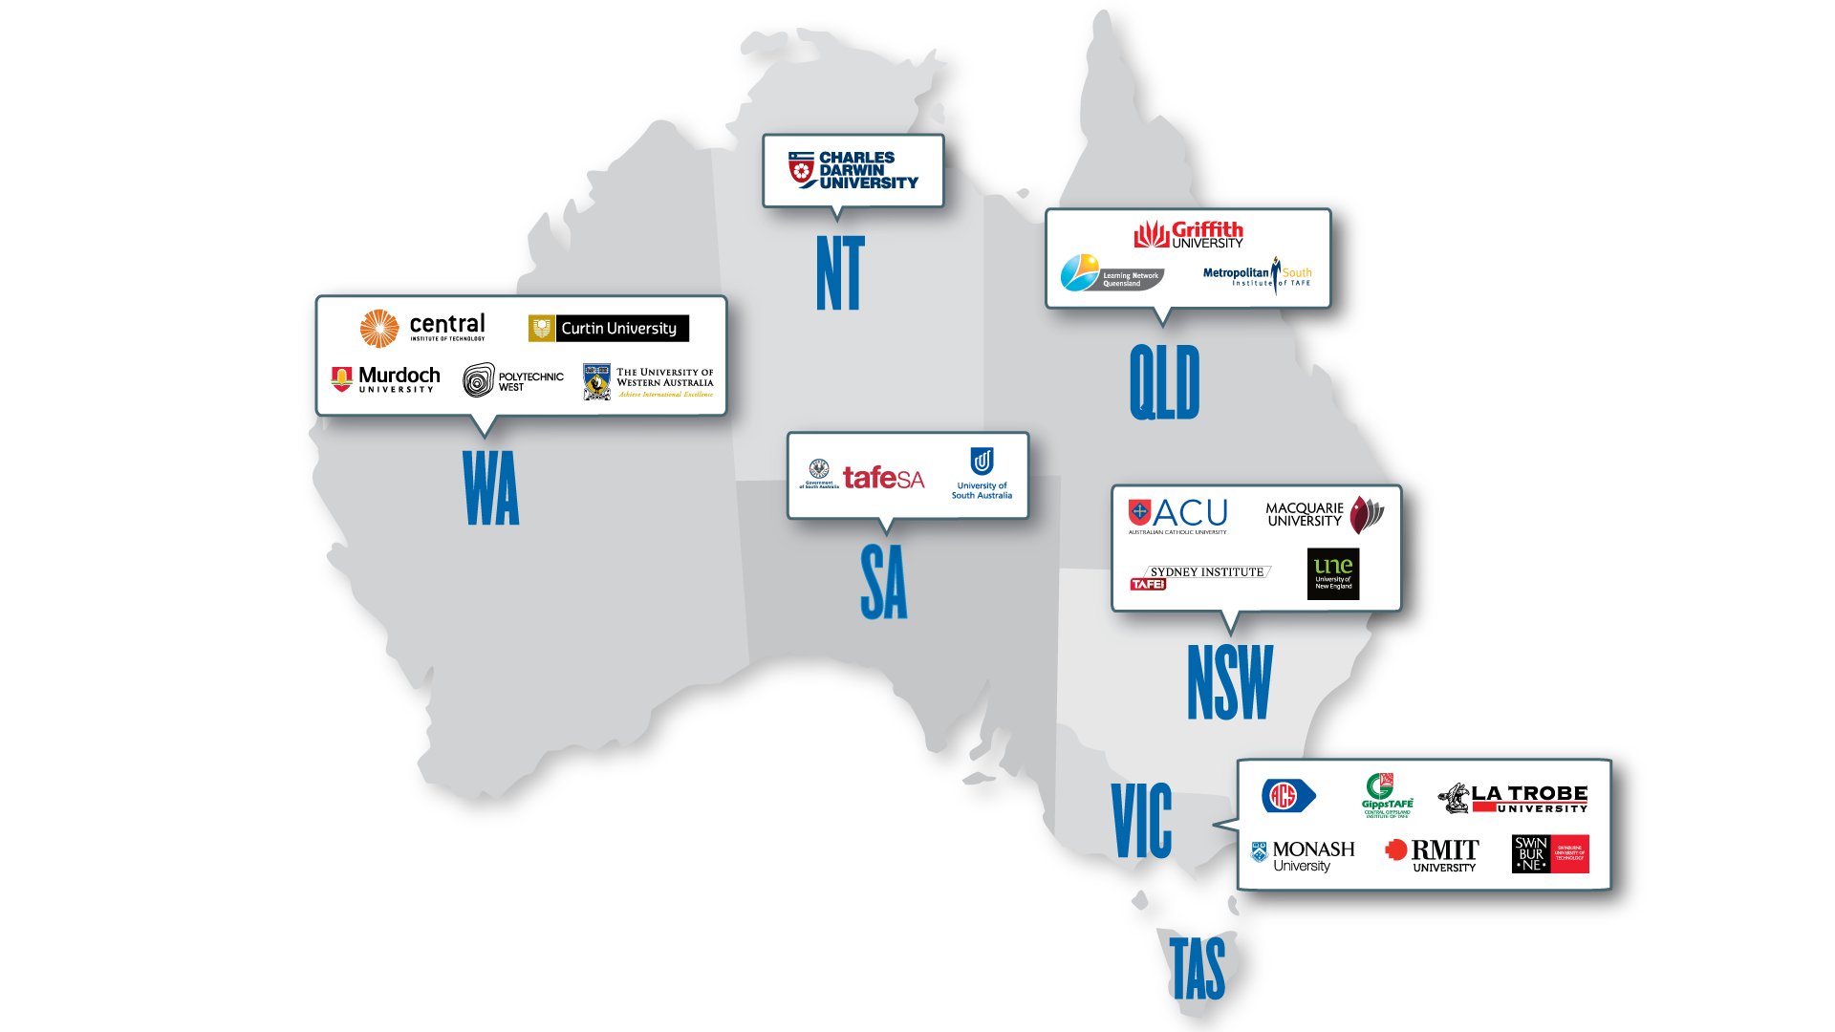
What is OUA?
Notes:
- Leading provider of online access to tertiary education
Not a university
Began 1993
- Owned by seven Australian universities
Offer courses from 20 leading Australian unis
Over 180 courses and 1700 individual units
7 areas of study
Offer preparatory units to postgraduate qualifications

Slide 3


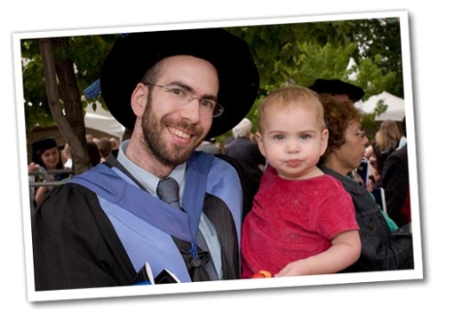

Who are OUA students?
Notes:
OUA students are typically “non-traditional” cohorts
OUA students have multiple responsibilities
Often with little prior educational experience
Combined with lack of time, money or both
- Relatively few come straight from school to study with OUA
- Mostly mature-age (>21), in paid employment and/or caring for children
- Around half of OUA students are first in family to come to university

Slide 4
Online Student Engagement Challenges
How do we engage with students in a meaningful way when we never see them face-to face?
How do we help students engage with each other when they never come together as a group?
How do we engage them with a learning community when they may be studying across two or more institutions?
Notes:
On-going challenges and questions of quality online student engagement

Slide 5
Alignment of objectives
OUA Connect
“To assist and support OUA student with resources and services in local communities through public libraries”
Library Council
“To develop and support individual and community lifelong learning wellbeing and social inclusion”
Notes:
Birth of the OUA Connect library program

Slide 6
OUA Connect objectives
Promote libraries
Place where OUA students can access relevant resources
Network with other OUA students in their community
Provide info
To library staff about OUA in general and support services for students
Enable them to better assist OUA students

Slide 7
Roles and Responsibilities
Showcase library services
Local Libraries
Provide basic IT assistance
Introduce students to study resources
Hand-out of OUA services at sessions
Provide student feedback
Provide training & on-going support
OUA
Tele-conference each study period
Supply of current OUA resources
Evaluate and report on outcomes
Promote library sessions

Slide 8


OUA Connect library pilot: Aug ‘12 – Feb ‘13
2 NSW Councils
4
libraries
1 training session
2
types of sessions
Notes:
OUA Connect library program
Promoted 4 local libraries in NSW (Wyong & Shellharbour) as places where OUA students could:
Find out about the library resources which can assist them with their studies and how to access them
network with other OUA students
OUA delivered a training session and provided information about OUA, its study patterns and support services, to library staff
Libraries ran weekly drop in sessions for OUA (and other online students) in their local communities

Slide 9
Evaluation of Pilot
2. Meet other students
7.5 rating recommend
70%
come back
85% helpful
5% of total cohort
1. Library resources/services
Notes:
20 students attended – 5% of total student cohort living within library regions attended at least one session (20 students out of 400)
Weekly evaluation positive
85% found library session helpful and increased their confidence in studying online
7.5 out of 10 score rating for recommending OUA Connect library sessions to other students
70% would continue attending sessions next study period

Slide 10
What’s happened since then until now?
New students
Welcome to your library session
Additional promotion of session
What your library offers
Library tour
Recommended action plan
Survey monkey
Feedback forms
Tea/Coffee/Biscuits
Notes:
Since Feb 2013 until now…
Welcome to your library session is the most attended type of session
While we send comms to all enrolled students based on library council postcodes, it is recommended for new students
A few libraries have also extended their sessions to distance ed and high school students.

Slide 11

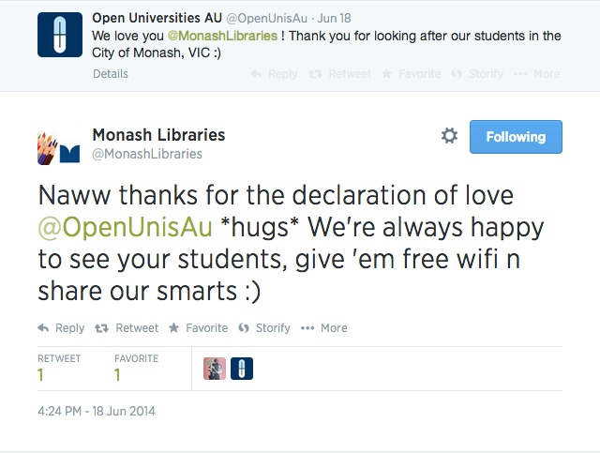
Monash Public Library Service

Slide 12

Why OUA Connect?
Provides a framework where we can support external students (part of our strategic direction of community engagement)
Value adds to our other library services (resume workshops, writers talks), promotes our resources
Providing opportunity for development: know our collection better and know our community better
Information but useful mechanism for community consultation to identify and address gaps within our service to meet students’ needs without duplicating what
is already available
Organic model that promotes transferrable
training materials

Slide 13
What’s our plans in the future…
OUA Connect across Australia
OUA Connect with Open 2 Study
areas with high #’s OUA students
Expand
Cross promote
Target
Notes:
Assists us with having more help on the frontline with marginal students who need it most
Piloting our own version of MOOCS, Open 2 Study to launch in 2015 – assisting students in this space
Mapping software identifying consistently large numbers of OUA students studying by postcodes
“Together we are stronger”

Slide 14
OUA Connect library program
Rose Hill
Student Engagement Coordinator
rose.hill@open.edu.au
(03) 8628-2421
www.open.edu.au

